Slide 1
Cycle Consistency in Normalizing Flow Models (FlowGAN)
Jen Weng

Slide 2
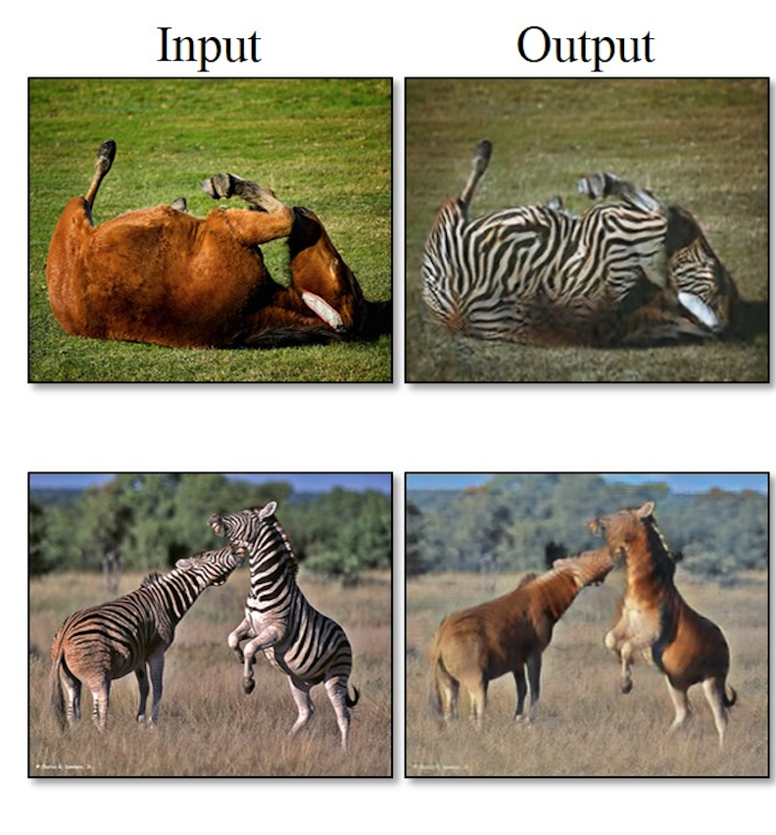
Unsupervised Image-to-Image Translation
Zhu, J. Y., Park, T., Isola, P., & Efros, A. A. (2017). Unpaired image-to-image translation using cycle-consistent adversarial networks. arXiv preprint.

Slide 3
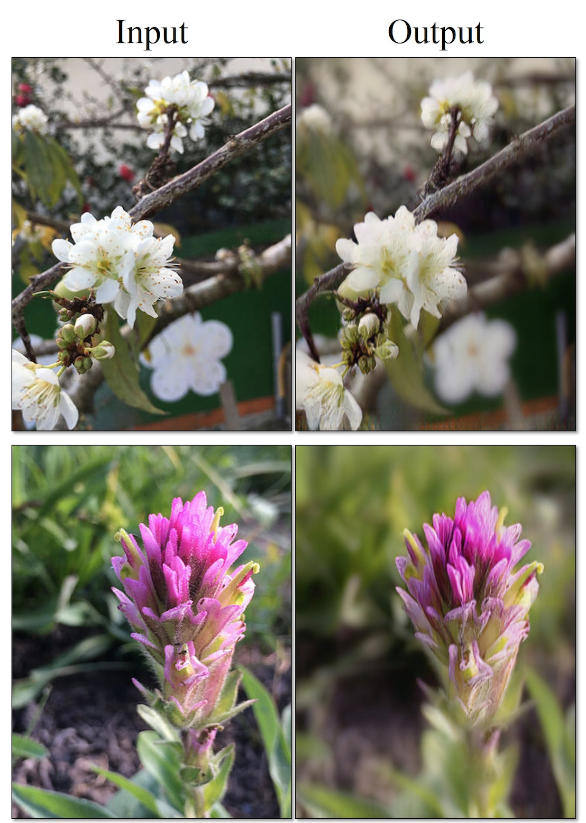
Zhu, J. Y., Park, T., Isola, P., & Efros, A. A. (2017). Unpaired image-to-image translation using cycle-consistent adversarial networks. arXiv preprint.

Slide 4
Introduction
CycleGan is GAN network that learns image-to-image translation. It augments the GAN loss with another term (cycle loss) that ensures that translating from one domain to another is reversible (or “cycle-consistent”). Normalizing flow models automatically guarantee such consistency.
In this project, we leveraged a flow model as a replacement to the cycle loss term in the CycleGAN objective. We implemented a flow model to learn the translation G: X->Y.
Since flow models are invertible, by passing the image of style B through the inverse of the flow (F: Y->X), we will get the translated image of style A.

Slide 5
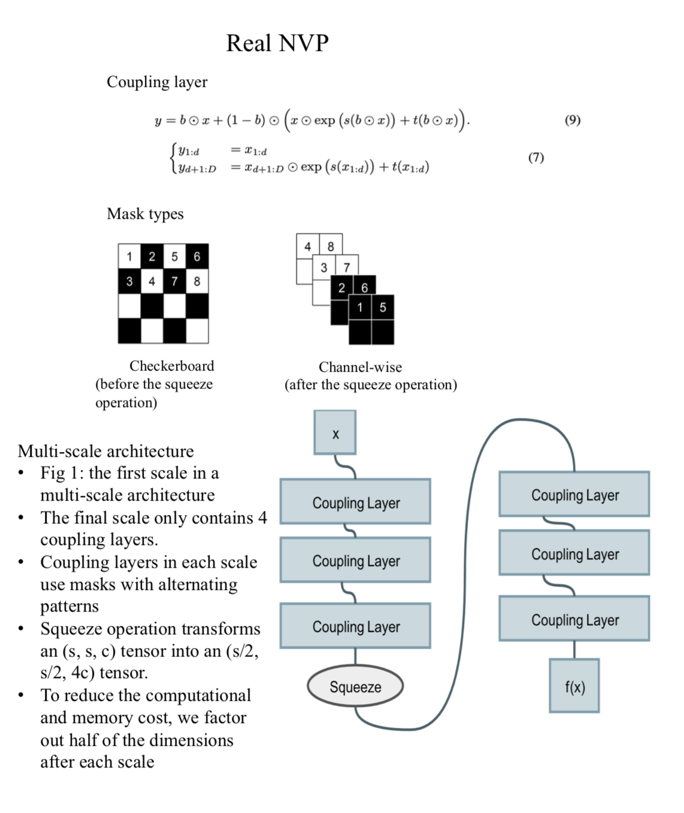

Slide 6
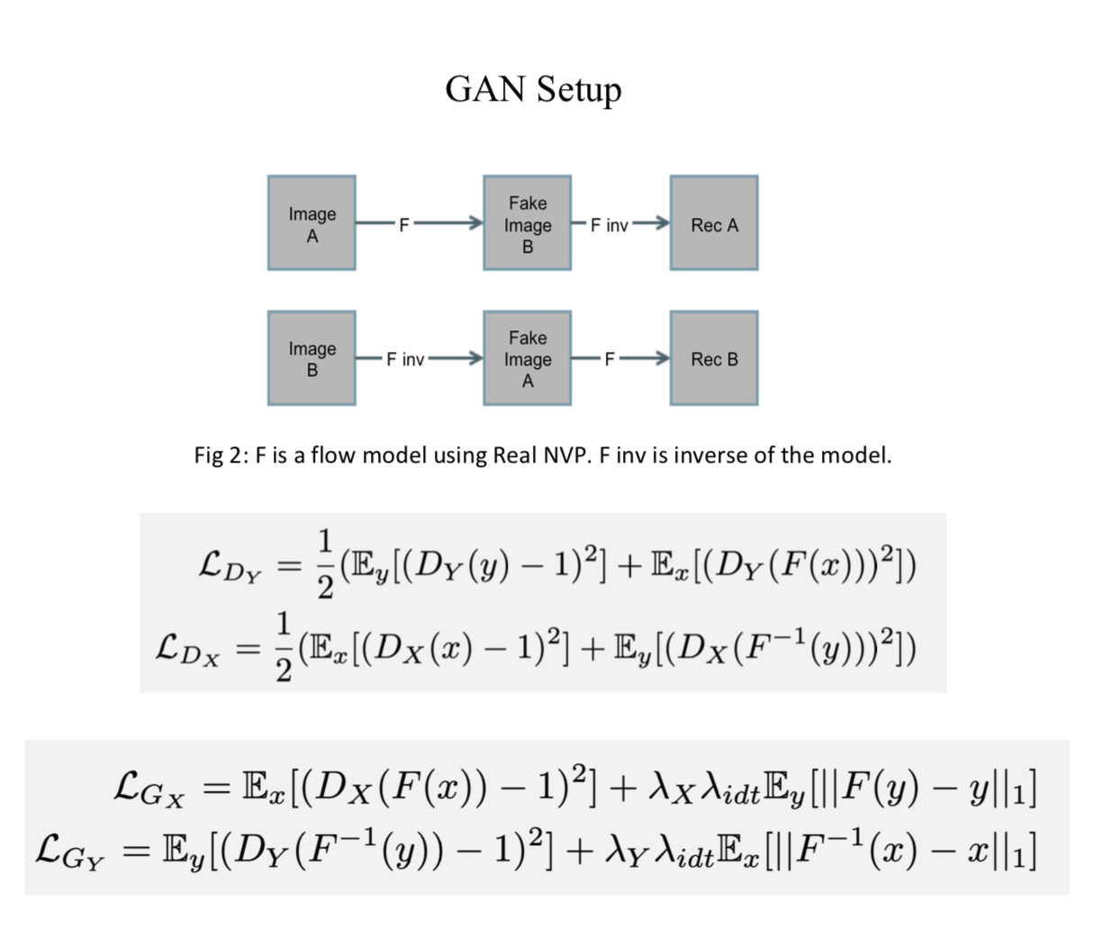

Slide 7
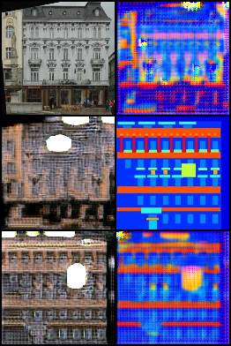
CycleGAN on Facades Dataset
Real x
G(x)
Rec x = F(G(x))
Real y
F(y)
Rec y = G(F(y))

Slide 8
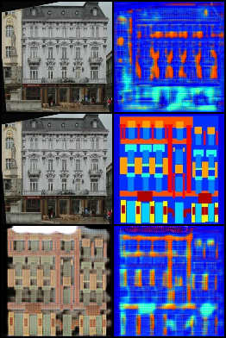
FlowGAN on Facades Dataset
Real x
G(x)
Rec x = F(G(x))
Real y
F(y)
Rec y = G(F(y))
Notes:
CycleGAN

Slide 9
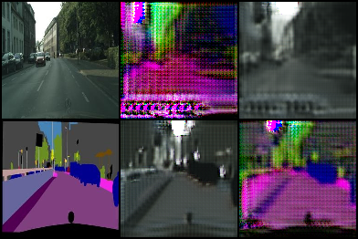
CycleGAN on Cityscapes Dataset
Real x
G(x)
Rec x = F(G(x))
Real y
F(y)
Rec y = G(F(y))
Notes:
Flowgan

Slide 10
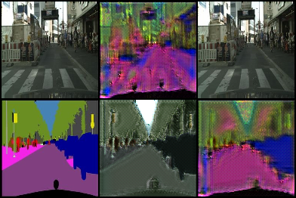
FlowGAN on Cityscapes Dataset
Real x
G(x)
Rec x = F(G(x))
Real y
F(y)
Rec y = G(F(y))
Notes:
Flowgan

Slide 11
